Slide 1
How to display all elements of an array ?
momedaram

Slide 2
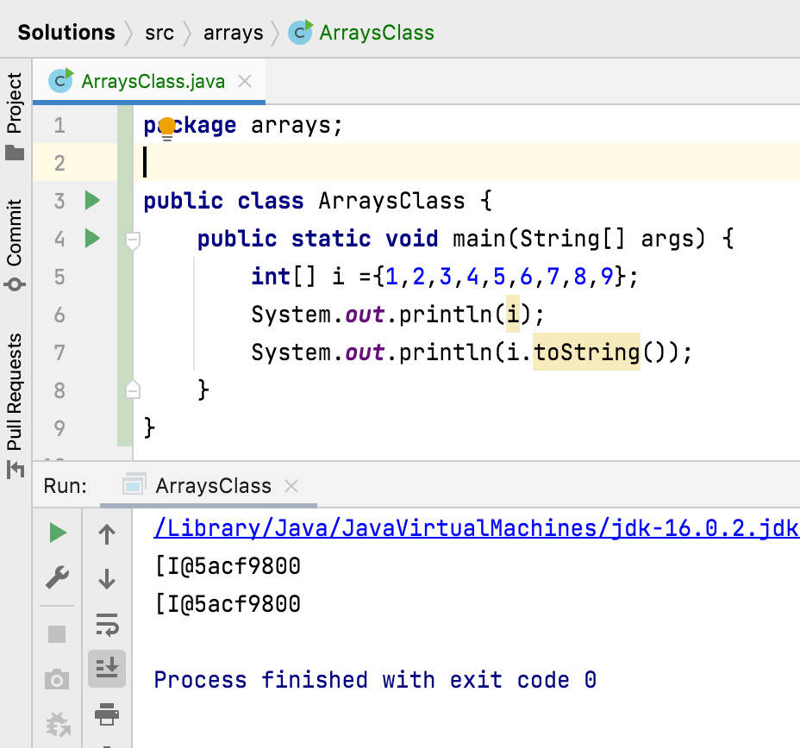
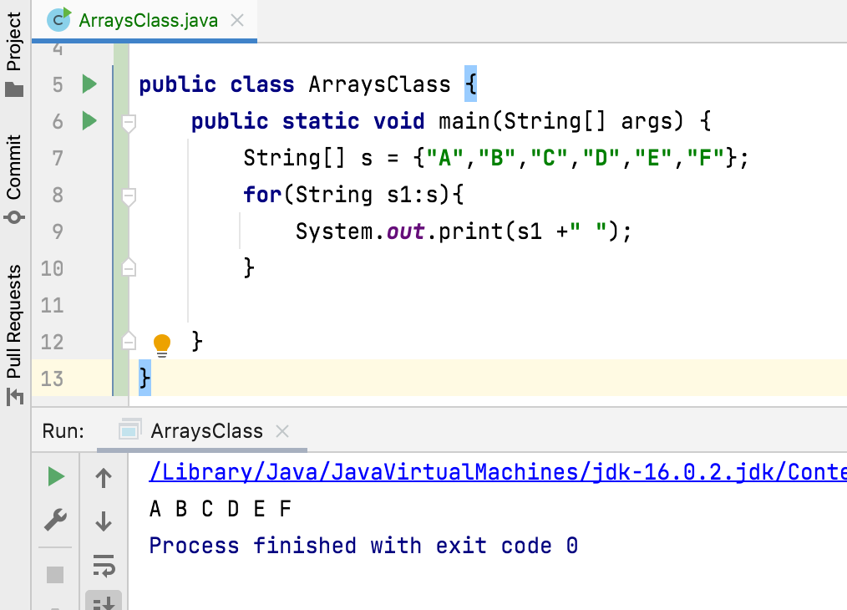
How to display all elements of an array ?

Slide 3
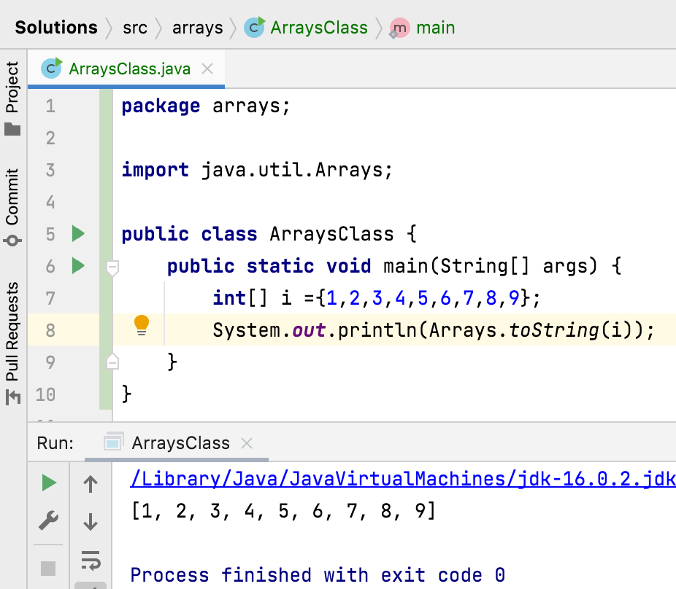
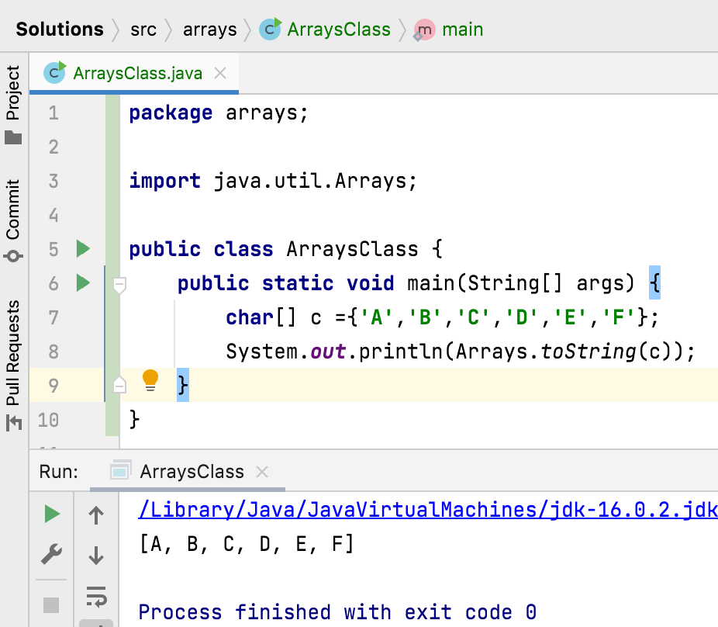

Slide 4
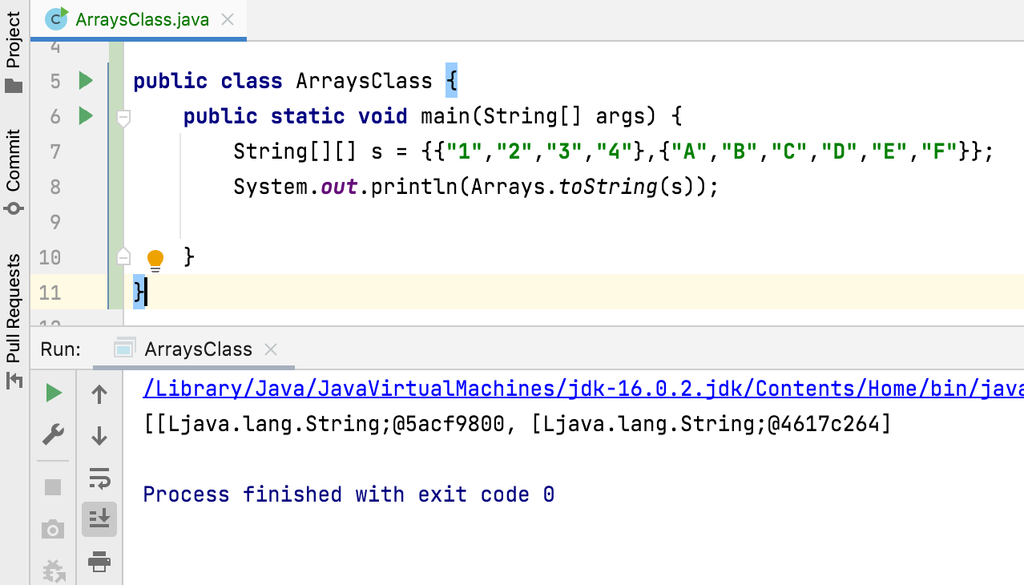

Slide 5
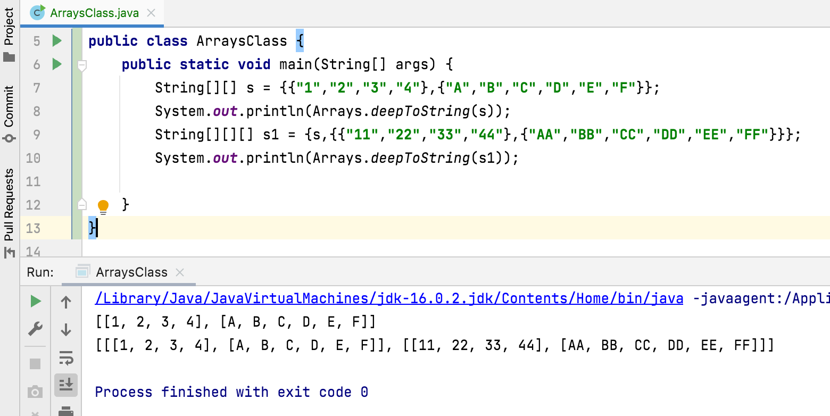

Slide 6
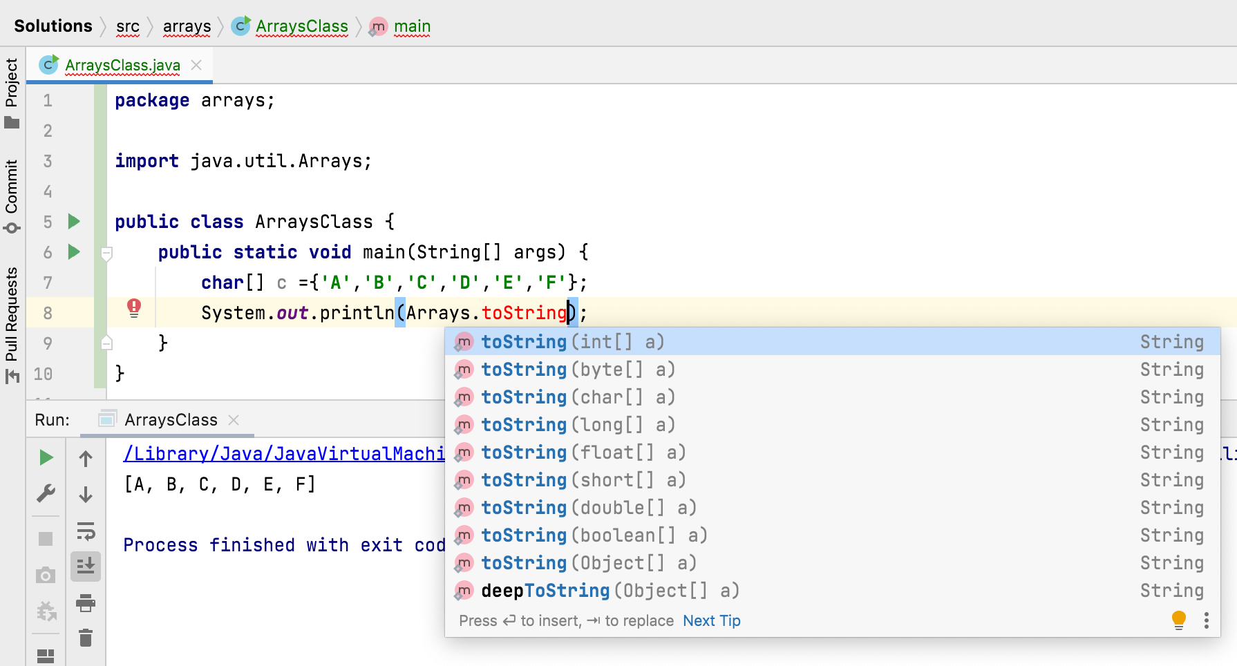

Slide 7
How to display all elements of an array ?
Arrays.toString()
Returns a string representation of the contents of the specified array.
String representation - list of the array's elements, enclosed in square brackets ("[]") & elements are separated by the characters ", " (a comma followed by a space).
Arrays.deepToString()
Returns a string representation of the "deep contents" of the specified array.
If the array contains other arrays as elements, the string representation contains their contents and so on.
This method is designed for converting multidimensional arrays to strings

